Slide 1

Foundation PHYSICS
Seminar 9: MAGNETISM & INDUCTION

Slide 2
Learning outcomes
Students will be able to :
Solve problems on magnetic force on moving charged particles.
Solve problems on magnetic field generates by straight line conductors.
Solve problems on electromagnetic induction.
Study applications of electromagnetic induction, such as the generator and the transformer.

Slide 3
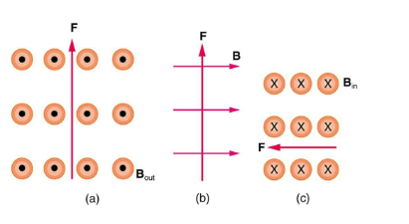
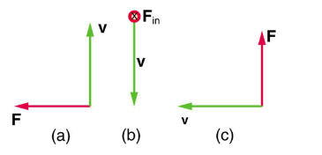
Practices Questions
What is the direction of the velocity of a negative charge that experiences the magnetic force shown in each of the three cases below.
What is the direction of the magnetic field that produces the magnetic force on a positive charge as shown in each of the three cases

Slide 4
ANSWER: Practices Question 1
Into page
South (down)
East (right)

Slide 5
ANSWER: Practices Question 2
Into page
West (left)
Out of page

Slide 6
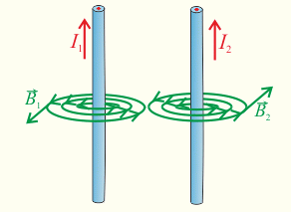
Question 1
Two straight parallel wires are separated by 6.0 cm. There is a 2.0 A current flowing in the first wire. If the magnetic field strength is found to be 0 T between the two wires at 2.2 cm from the first wire, what is the magnitude and direction of the current in the second wire?

Slide 7
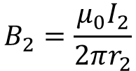


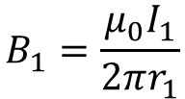


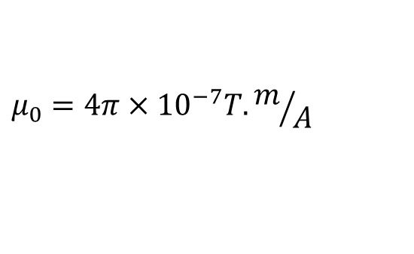
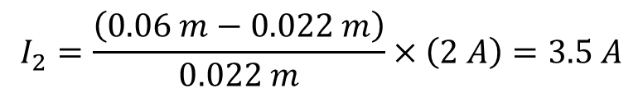


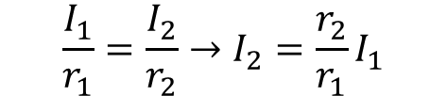

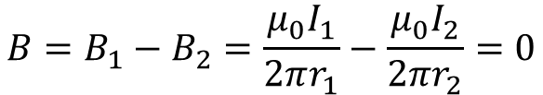

Question 1: ANSWERS
Given
$$I_{1}=2.0 A$$
$$r_{1}=0.022 m$$
$$I_{2}=? A$$
$$r_{2}=0.06 m −0.022 m$$
$$B_{1}=\frac{μ_{0}I_{1}}{2πr_{1}}$$
$$B_{2}=\frac{μ_{0}I_{2}}{2πr_{2}}$$
$$μ_{0}=4π×{10}^{−7}T.m/A$$
$${B=B}_{1}−B_{2}=\frac{μ_{0}I_{1}}{2πr_{1}}−\frac{μ_{0}I_{2}}{2πr_{2}}=0$$
$$I_{1}$$
$$I_{2}$$
$$\frac{I_{1}}{r_{1}}=\frac{I_{2}}{r_{2}}→I_{2}=\frac{r_{2}}{r_{1}}I_{1}$$
$$r_{1}$$
$$r_{2}$$
$$I_{2}=\frac{\left(0.06 m−0.022 m\right)}{0.022 m}×\left(2 A\right)=3.5 A$$

Slide 8
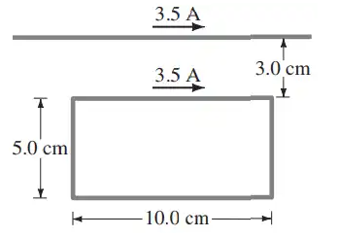
Question 2
A rectangular loop of wire is placed next to a straight wire. There is a current of 3.5 A in both wires. Determine the magnitude and direction of the net force on the loop.

Slide 9









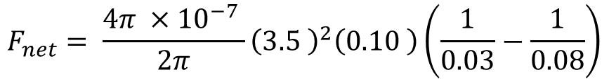


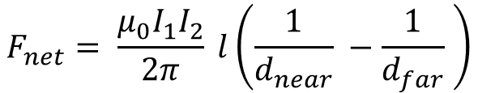
Question 2: ANSWERS
Using the right hand rule, the total force on the left and right segments of wire is zero, and so only the parallel segments need to be considered in the calculation.
$$3.5 A$$
$$F_{1}$$
$$3.5 A$$
$$3.0 cm$$
$$5.0 cm$$
$$F_{4}$$
$$F_{3}$$
$$F_{2}$$
$$10.0 cm$$
$$F_{net}=F_{1}−F_{2}$$
$$F_{net}= \frac{μ_{0}I_{1}I_{2}}{2π} l\left(\frac{1}{d_{near}} −\frac{1}{d_{far}} \right)$$
$$F_{net}= \frac{4π ×{10}^{−7} }{2π}{\left(3.5 \right)}^{2}\left(0.10 \right)\left(\frac{1}{0.03}−\frac{1}{0.08}\right)$$
$$F_{net}=5.1×{10}^{−6}N, up the page$$

Slide 10
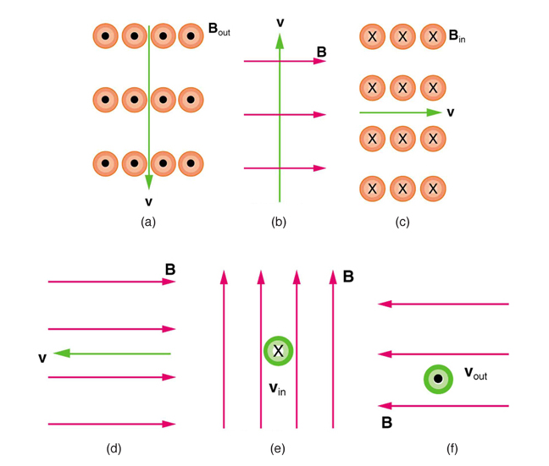
Question 3
What is the direction of the magnetic force on a positive charge that moves as shown in each of the six cases shown below.

Slide 11
Question 3: ANSWERS
Up (North)
Left (West)
Into the page
No force
Right (East)
Down (South)

Slide 12
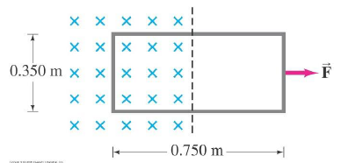
Question 4
Part of a single rectangular loop of wire with dimensions shown in the figure below is situated inside a region of uniform magnetic field of 0.650 T. The total resistance of the loop is 0.280 Ω. Calculate the force required to pull the loop from the field (to the right) at a constant velocity of 3.40 m/s. Neglect gravity.

Slide 13
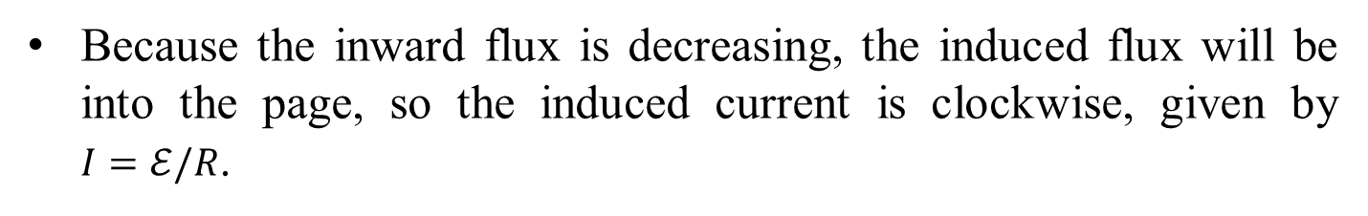
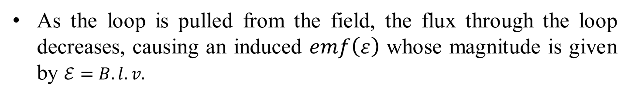

Question 4: ANSWERS
As the loop is pulled from the field, the flux through the loop decreases, causing an induced $emf\left(ε\right)$ whose magnitude is given by $ℰ=B.l.v.$
Because the inward flux is decreasing, the induced flux will be into the page, so the induced current is clockwise, given by $I=ℰ/R$.
Because this current in the left-hand side of the loop is in a downward magnetic field, there will be a magnetic force to the left.
To keep the rod moving, there must be an equal external force to the right, given by:
$$F=I.l.B$$

Slide 14
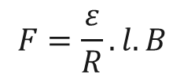
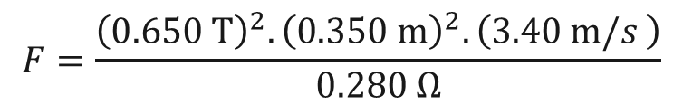


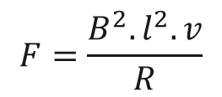
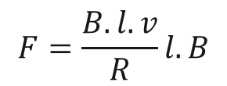
Question 4: ANSWERS
To keep the rod moving, there must be an equal external force to the right, given by:
$$F=I.l.B$$
$$F=\frac{ε}{R}.l.B$$
$$F=\frac{B.l.v}{R}l.B$$
$$F=\frac{B^{2}.l^{2}.v}{R}$$
$$F=\frac{{\left(0.650 T\right)}^{2}.{\left(0.350 m\right)}^{2}.\left(3.40 m/s \right)}{0.280 Ω}$$
$$F=0.628 N$$

Slide 15
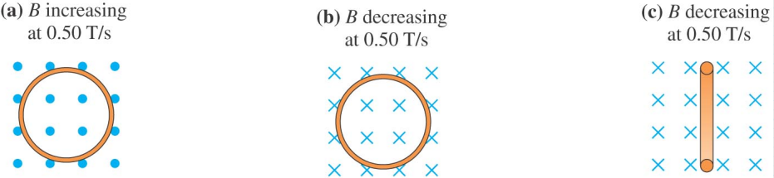
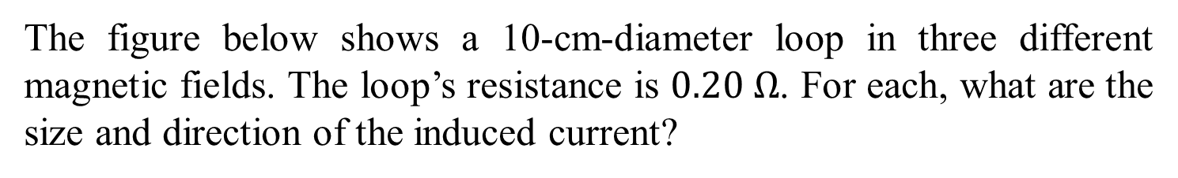
Question 5
The figure below shows a 10-cm-diameter loop in three different magnetic fields. The loop’s resistance is $0.20 Ω$. For each, what are the size and direction of the induced current?

Slide 16

Question 5: NOTE
Faraday’s Law:
$$ε=−\frac{dΦ_{B}}{dt}$$
The negative sign indicates that the induced EMF (and corresponding current) opposes the change causing it.
It represents nature's tendency to oppose changes in magnetic flux.
This opposition is what we call Lenz's law.

Slide 17

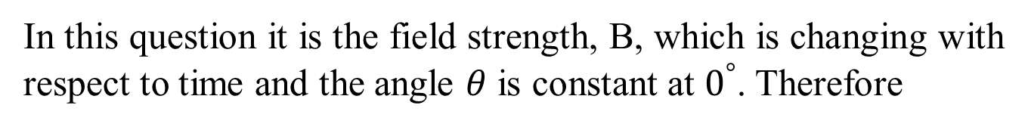
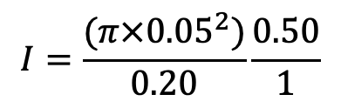
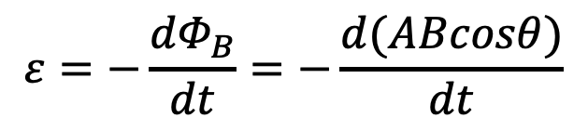


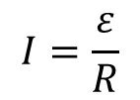

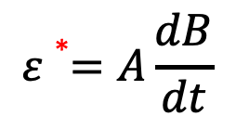

Question 5: ANSWERS
First we need to determine the change in magnetic flux in each case.
$$ε=−\frac{dΦ_{B}}{dt}=−\frac{d(ABcosθ)}{dt}$$
In this question it is the field strength, B, which is changing with respect to time and the angle $θ$ is constant at $0^{°}$. Therefore
$$ε∗=A\frac{dB}{dt}$$
$$I=\frac{ε}{R}$$
$I=\frac{ε}{R}=\frac{A}{R}|\frac{dB}{dt}$ |
$$I=\frac{(π×{0.05}^{2})}{0.20}\frac{0.50}{1}$$
$$I=0.0196A$$
*We ignore the sign but take into account its meaning in what it follows:
(a) 𝐵 𝑖𝑛𝑐𝑟𝑒𝑎𝑠𝑖𝑛𝑔 𝑎𝑡 +0.5 𝑇/𝑠
(b) 𝐵 decreasing 𝑎𝑡 -0.5 𝑇/𝑠
$$I=0.0196A \left(ClockWise\right)$$
$$I=0.0196A \left(ClockWise\right)$$
(c) 𝐵 decreasing 𝑎𝑡 0.5 𝑇/𝑠
$$I=0 A$$

Slide 18
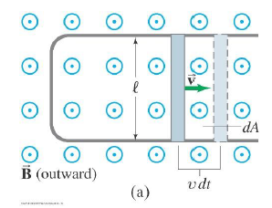
Question 6
A rod moves to the right with a speed of 1.3 m.s⁻¹ and has a resistance of 2.5 Ω. The rail separation is 𝑙 = 25.0 cm. The magnetic field is 0.35 T, and the resistance of the U-shaped conductor is 25.0 Ω at a given instant. Calculate
the induced emf,
the current in the U-shaped conductor, and
the external force needed to keep the rod's velocity constant at that instant.

Slide 19



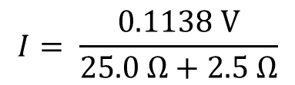


Question 6: ANSWERS
(a) the induced emf
Because the velocity is perpendicular to the magnetic field and the rod, the induced emf is calculated as:
$$ℇ=B.l.v$$
$$ℇ= \left(0.35 T\right).\left(0.250 m\right).\left(1.3 m/s\right)=0.1138 V$$
(b) the current in the U-shaped conductor
Find the induced current from Ohm’s law, using the total resistance
$$I= \frac{ℇ}{R}$$
$$I= \frac{0.1138 V}{25.0 Ω+2.5 Ω}$$
$$I=4.138{×10}^{−3}A ≈4.1 mA$$
(c) the external force
$$F=I.l.B$$
$$F=\left(4.138×{10}^{−3} A\right).\left(0.250 m\right).\left(0.35 m/s\right)$$
$$F=3.621×{10}^{−4}N$$

Slide 20
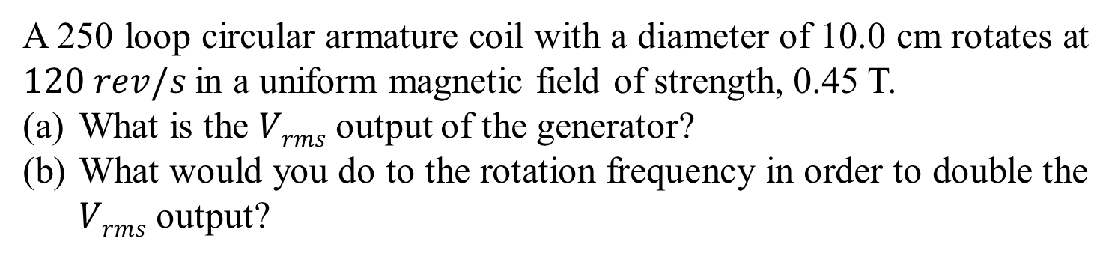
Question 7
A 250 loop circular armature coil with a diameter of 10.0 cm rotates at $120 rev/s$in a uniform magnetic field of strength, 0.45 T.
What is the $Vrms$ output of the generator?
What would you do to the rotation frequency in order to double the $Vrms$ output?

Slide 21
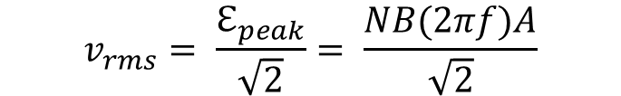

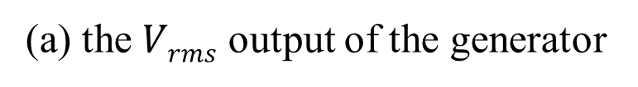


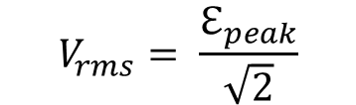
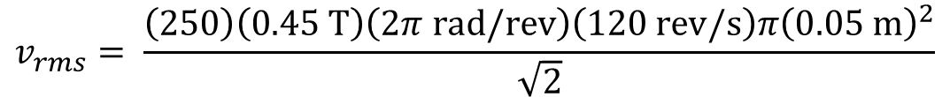
Question 7: ANSWERS
(a) the $Vrms$ output of the generator
Rms voltage, $Vrms$ is found from the peak induced emf, $ℇ_{peak}$
$$V_{rms}= \frac{ℇ_{peak}}{\sqrt{2}}$$
The peak induced emf, $ℇ_{peak}$ is calculated from the equations:
$$ℇ_{peak}=NBωA$$
$$where, ω=2πf$$
$$v_{rms}= \frac{ℇ_{peak}}{\sqrt{2}}= \frac{NB(2πf)A}{\sqrt{2}}$$
$$v_{rms}= \frac{\left(250\right)\left(0.45 T\right)\left(2π rad/rev\right)\left(120 rev/s\right)π{\left(0.05 m\right)}^{2}}{\sqrt{2}}$$
$$v_{rms}=471.1 V ≈470 V$$
(b) to double the V_{rms} output
To double the output voltage, double the rotation frequency to 240 rev/s.

Slide 22
Question 8
A model-train transformer plugs into 120 V AC and draws 0.35 A while supplying 7.5 A to the train. Assume the transformer is ideal.
What voltage is present across the tracks?
Is the transformer step-up or step-down?

Slide 23
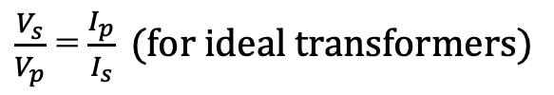

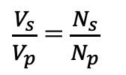
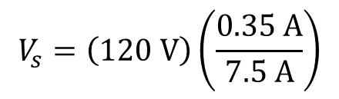

Question 8: ANSWERS
(a) voltage is present across the tracks
Use equations to relate the voltage and current ratios
$\frac{V_{s}}{V_{p}}$ = $\frac{N_{s}}{N_{p}}$
$\frac{V_{s}}{V_{p}}$ = $\frac{I_{p}}{I_{s}} (for ideal transformers)$
$V_{s}$ = $V_{p}$. $\frac{I_{p}}{I_{s}}$
$$V_{s}=\left(\text{120 }\text{V}\right)\left(\frac{0.35 A}{7.5 A}\right)$$
$$V_{s}=\text{5.6 }\text{V}$$
(b) Is the transformer step-up or step-down
Because $V_{s}<V_{p}$, this is a step-down transformer

